Slide 1
Integration of lines
§ Conservative vector fields
§ Line Integrals
§ A Test for Conservative fields
§ Green’s Formula
Visualize Materials

Slide 2
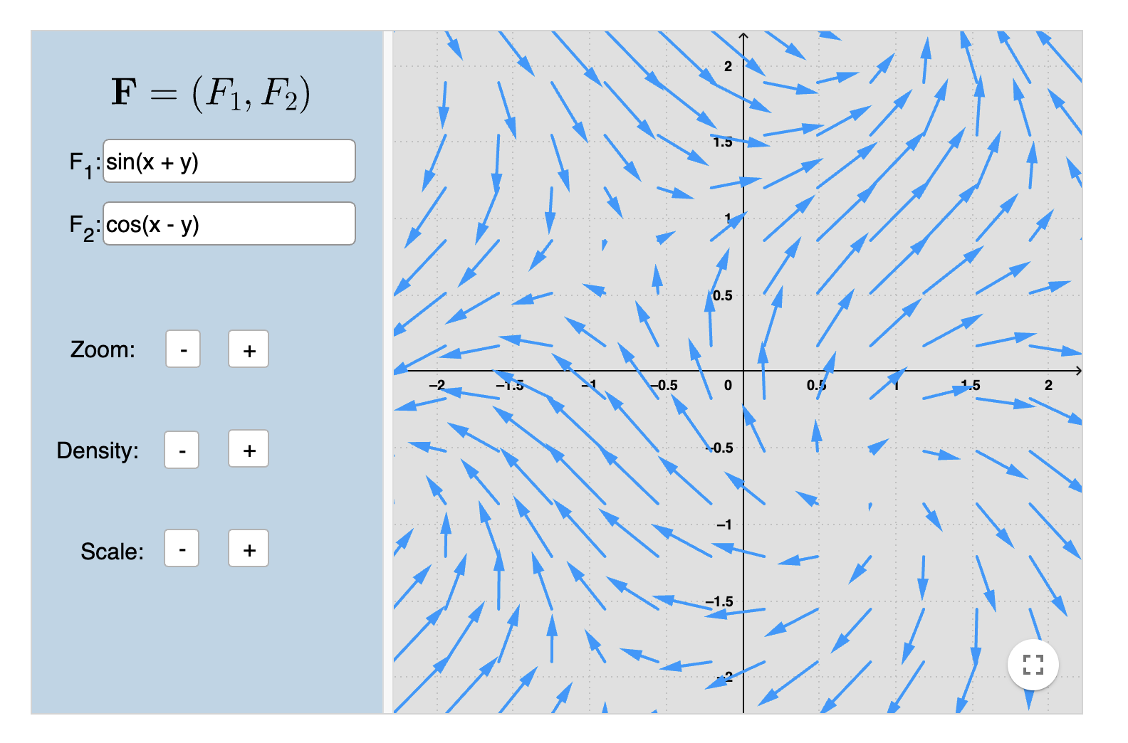
Visualizing vector field: Vector Fields in 2D – GeoGebra

Slide 3
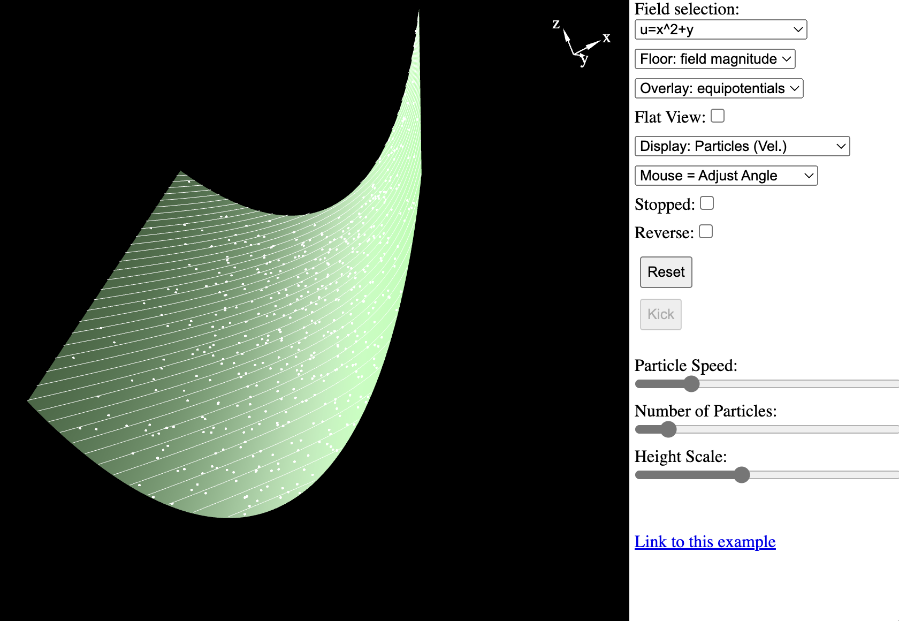
Visualizing vector field: A more intuitive way(2-D Vector Fields (falstad.com))

Slide 4
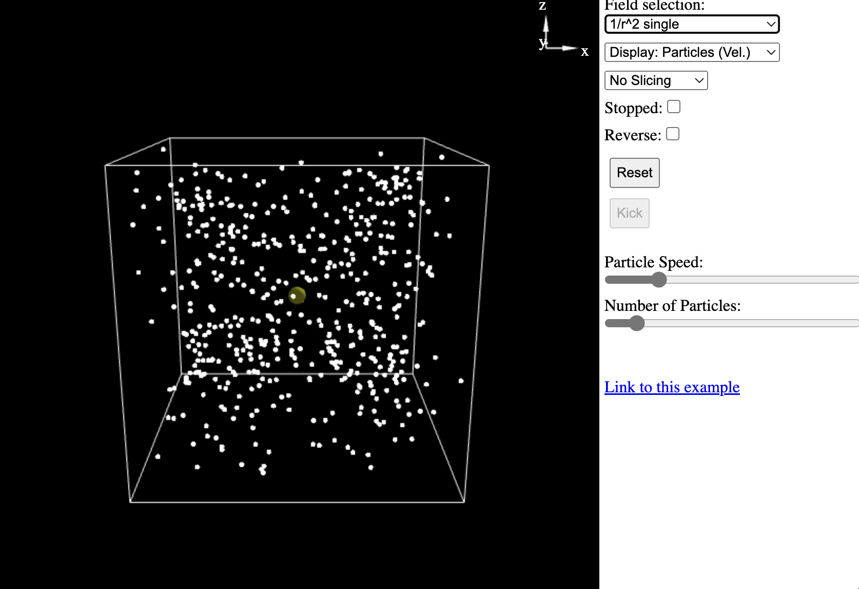
Visualizing vector field: A more intuitive way(3-D Vector Fields (falstad.com))

Slide 5
Works done by a changing force and a curve (MATH2001/7000 - Chapter 35)

Slide 6
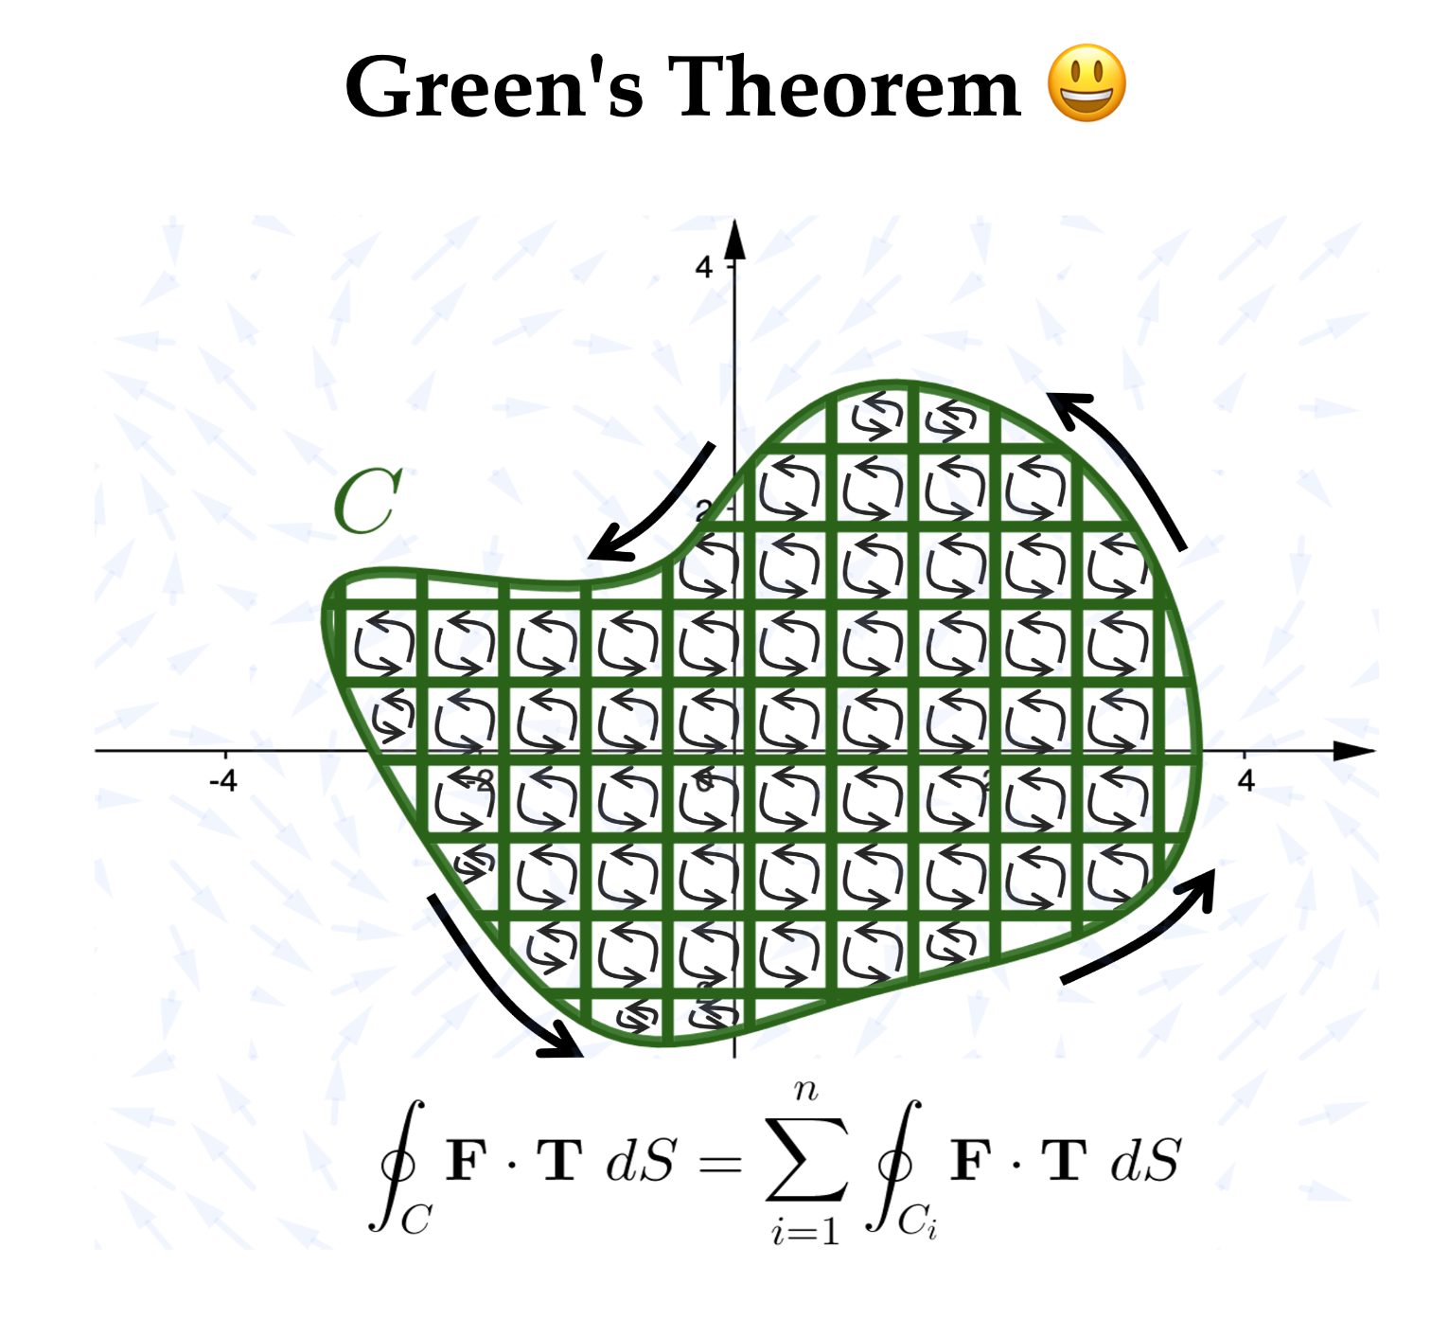
Green’s Theorem Intuitive Explanation (MATH2001/7000 - Chapter 36)

Slide 7
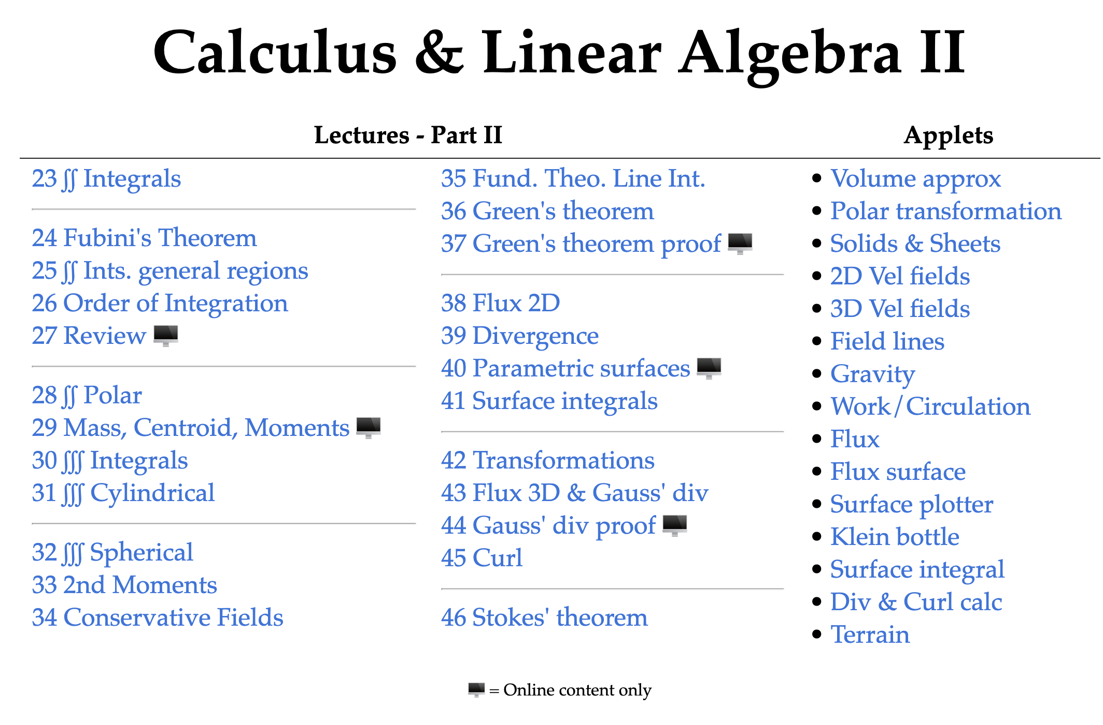
See more on MATH2001/7000 - Part II: Table of contents (dynamicmath.xyz)

